Slide 1
Housing Price Prediction with ML
Phil Okoth
Matthew Siriani
Robert Bellgraph
Vince DeScioli

Slide 2
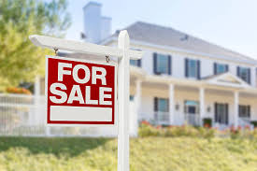

Overview
Buying and/or selling a home is one of the most important financial decisions in an individual’s life. The ability to predict home sales via machine learning provides important information and benefits to these investments in the real estate market.
The goal of this project was to analyze property sales records and fit the data to a model that help predict sale prices most accurately.
Several tools were used to accomplish this task and data was obtained from the link below..
Dataset: https://www.kaggle.com/datasets/shree1992/housedata

Slide 3
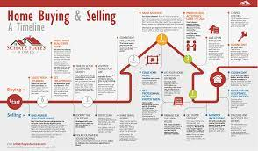
Project timeline
Step 1
Step 2
Step 3
Step 4
Step5
Step6
Obtain Data
Clean Data
Load Data
Descriptive Summaries
Machine Learning/ Neural Network
Fine Tune Model
Used internet to find the housing data
(kaggle.com)
Used Python Pandas to clean Data and save to csv.
Loaded the cleaned data to Postgres and exported to JupyterLab
Used Pandas, Matplotlib, and Seaborn to obtain numerical and graphical summaries of data.
Used SkLearn to prepare data for modeling, used tensorflow to train, fit and test model.
Used Keras tuner to find best combination of hyperparameters and best model.

Slide 4
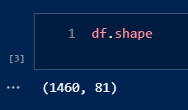
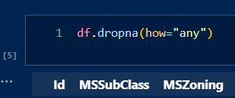
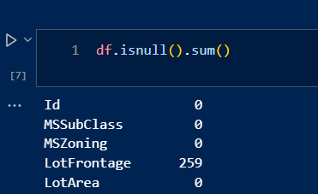
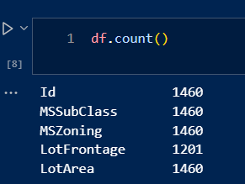
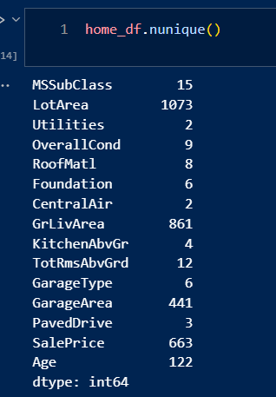
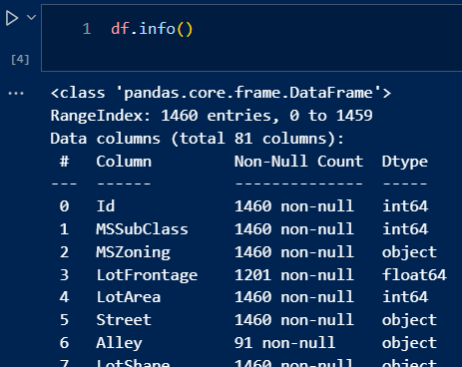
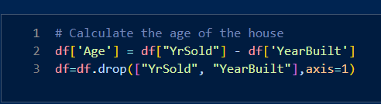
Data Cleaning

Slide 5
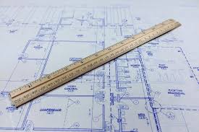
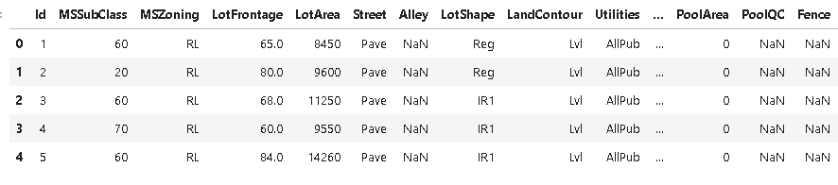
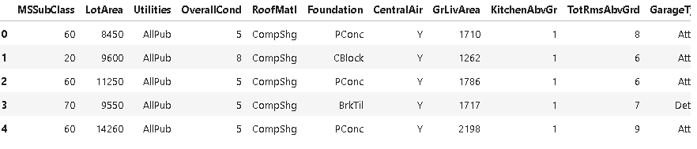
Data Structure
Before Cleaning:
After Cleaning:

Slide 6
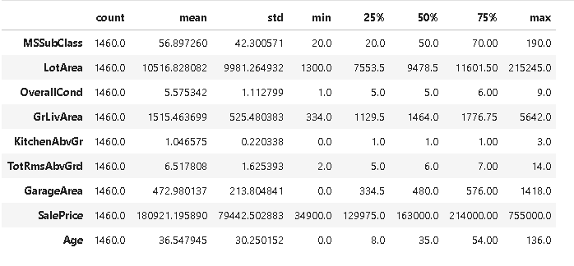
Summary Statistics

Slide 7
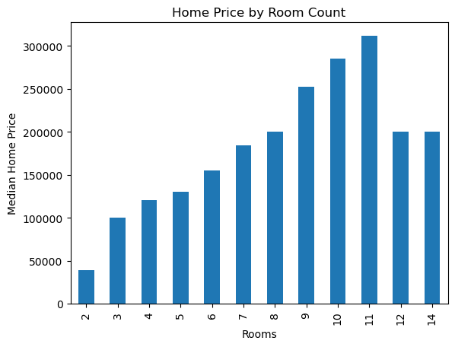
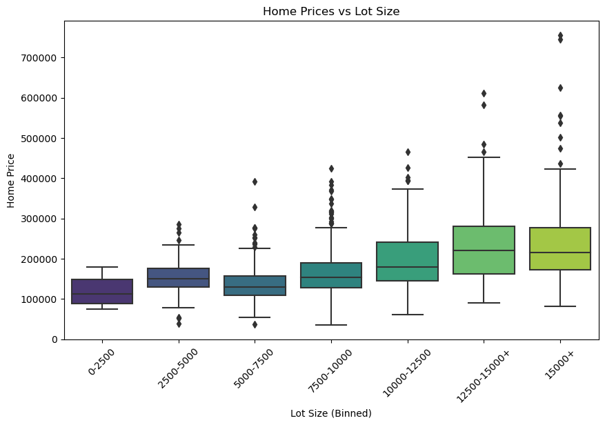
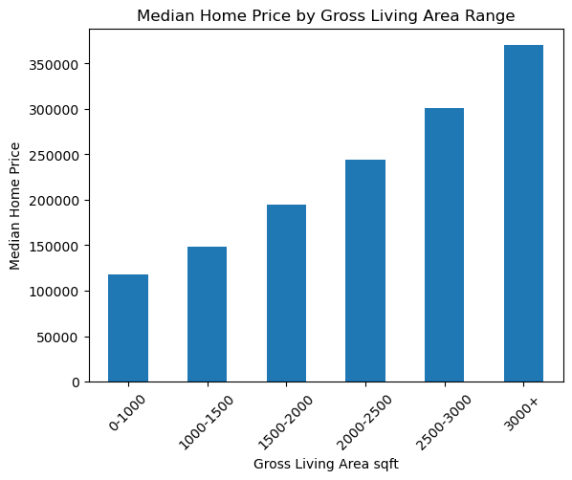
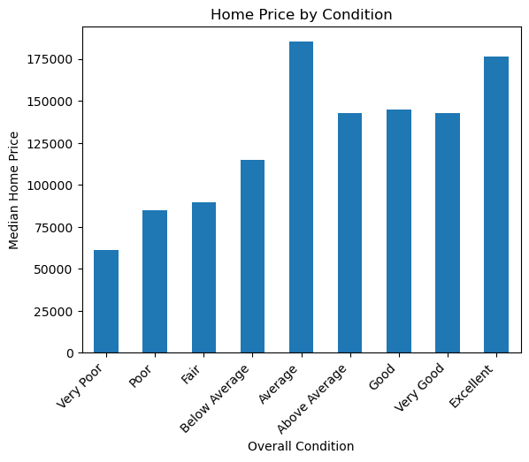
DATA EXPLORATION
Number of Rooms:
11 rooms(total) is most expensive.
12 & 14 are cheaper than 9 & 10.
Lot size:
2500 sf lots are more expensive than 5000 sf lots, above 1200 sf lots have no discernible difference.
Size of Home (square feet):
Price is directly related to size.
Rating:
Average is most expensive.
Above Averagely, Good & Very Good are similar.
Poor is the cheapest.

Slide 8
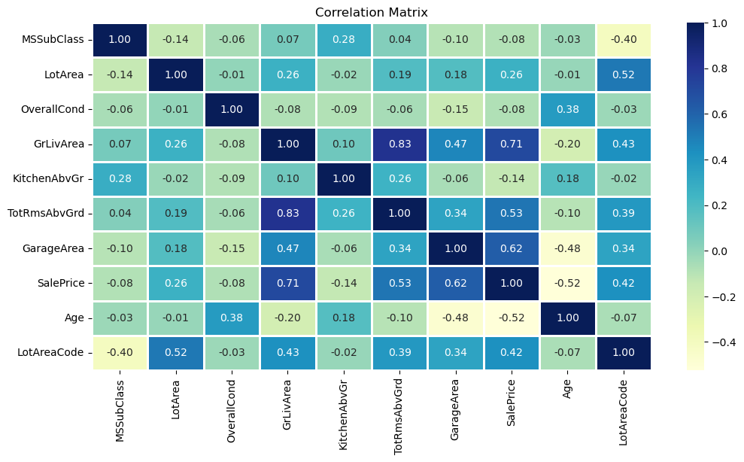
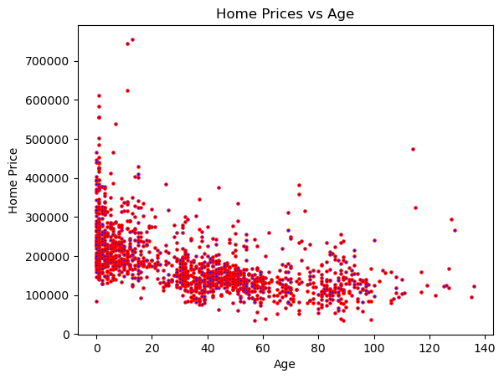
Correlations
The strongest linear relationship seems to be between Gross Living Area and Total Rooms Above Ground with the weakest relationship between Age and Lot Area. There is some weak relationships between the features.
Home price and home Age are negatively correlated with a few outliers.

Slide 9

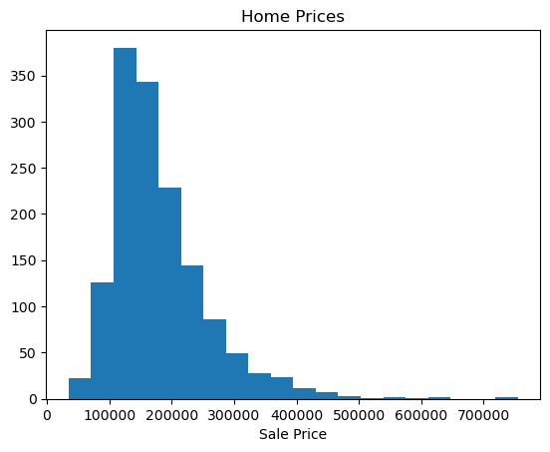
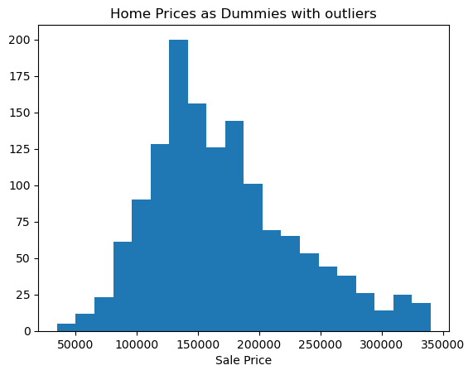
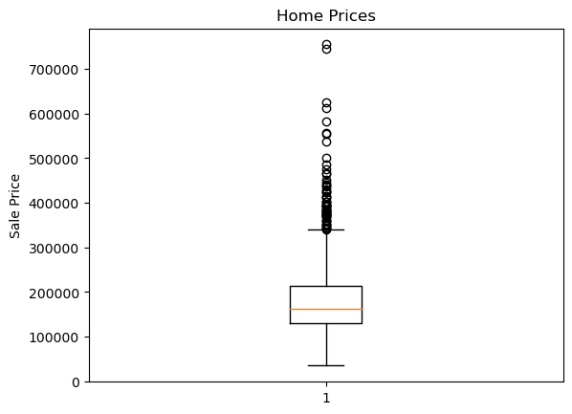
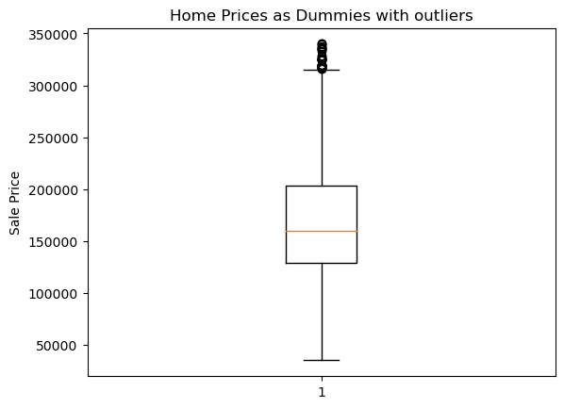
Sale-Price Distribution
The distribution of home prices exhibits a right skewness, accompanied by a few outliers, as depicted in the left chart.
After the removal of outliers, the distribution of prices appears to exhibit greater symmetry, as illustrated in the right chart.

Slide 10
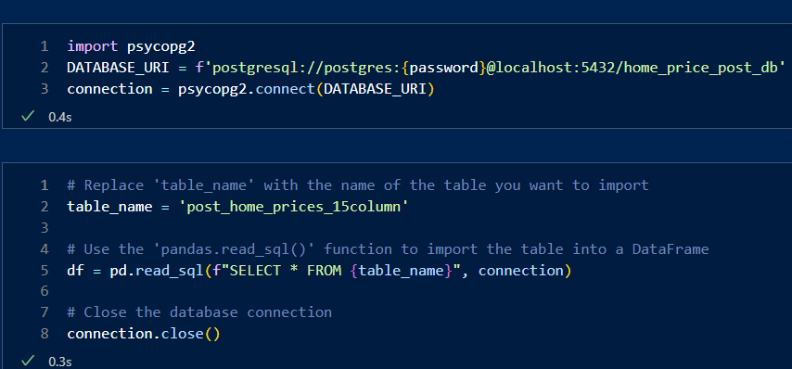
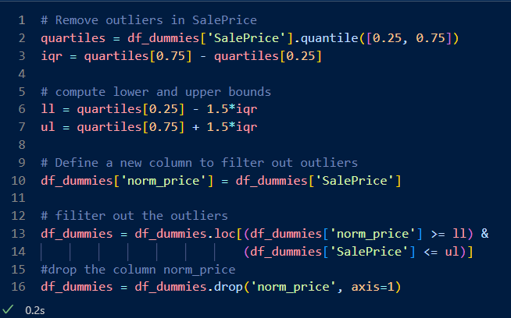
Data Preparation for Model Fitting
Connect to database, determine outliers in Sale-Price.

Slide 11
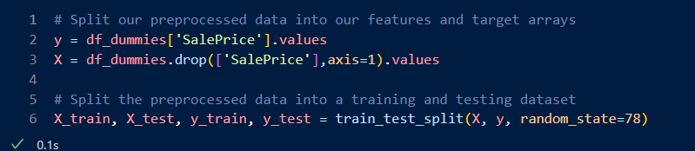
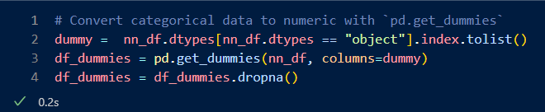
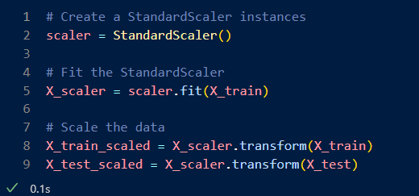
Data Preparation for Model Fitting
Set target & features.
Define train and test sets.
Create dummy features for the categorical features.
Scale the features for model training and fitting..

Slide 12
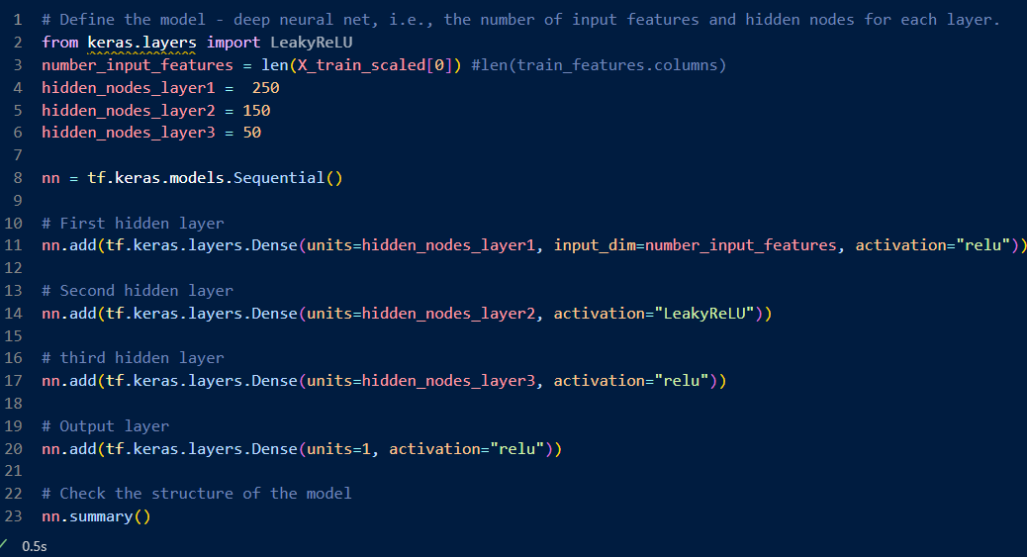
Neural Network Model

Slide 13



Machine Learning Model
Deep Learning Model:
Performance Metric: Root Mean Square Error
Target: Sales Price
Features:
SubClass | Zoning | Lot Area
Neighborhood | Bsmt SqFt | Roof Material
Condition | Foundation | Style
Exterior | Living Area | Fireplace
Total Rooms | Garage Type | Garage SqFt
Driveway | Age | Cent Air
Utilities | Bedrooms | Kitchen

Slide 14

Model Variations
 | Features | Neuron/Layers | Activation | Average RMSE
Model A | 15 | 75,75, 40 | relu | 32440
Model B | 22 | 50,50, 35 | relu, | 28642
Hyper Tuning Model | 22 | 43, 221, 243, 225, 35, 187 | relu | 25189

Slide 15

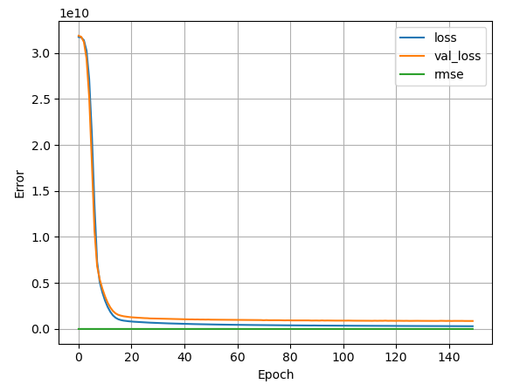
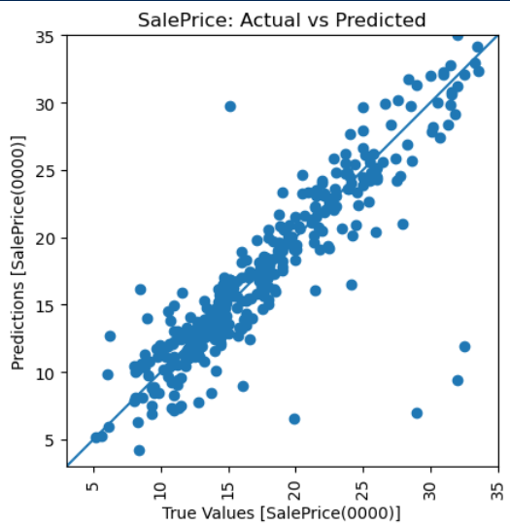
Model Results
3
250,150,50
570
23
Hidden Layers (ReLU)
Neurons /Layer
Loss (Millions)
RMSE (thousand)
After training and fitting the model the above were results obtained.

Slide 16
Conclusion
The best model was one that used all the features, with 3 hidden layers (250,150, 50) with activation function (relu) and achieved a rmse of 23060.
The model tended to underestimate rather than overestimate the prices.
Hyperparameter tuning did not result in a better model compared to the trial and error models.
With many features and missing values, it was hard to get a model that performed better than what we got.
The model can be improved by running feature importance and selecting only those that are important to rid model of unnecessary features.
Generally our model worked as expected but failed to achieve the most desired results, there is room for improvement.

Slide 17
Thank you!
Questions?

